Slide 1
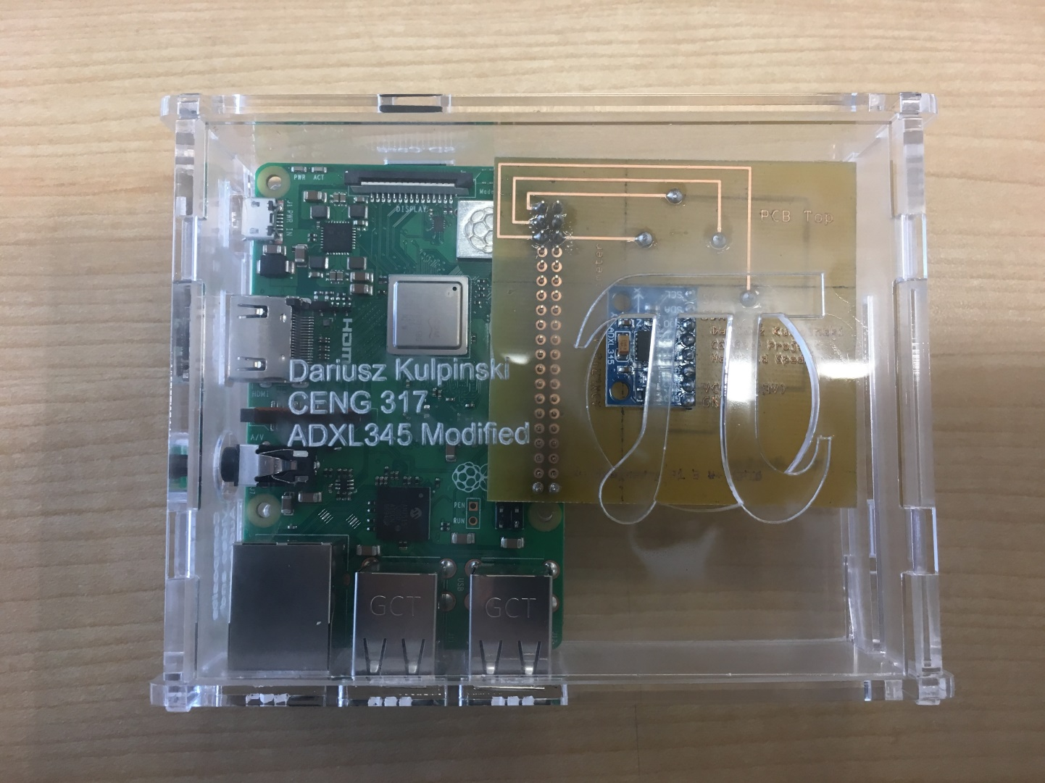
Hardware Production Tech Project: Handheld Speedometer
Dariusz Kulpinski | CENG 317 – 0NA | ADXL-345 3 Axis Accelerometer (0x53)

Slide 2
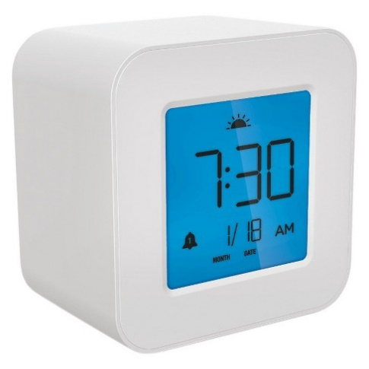
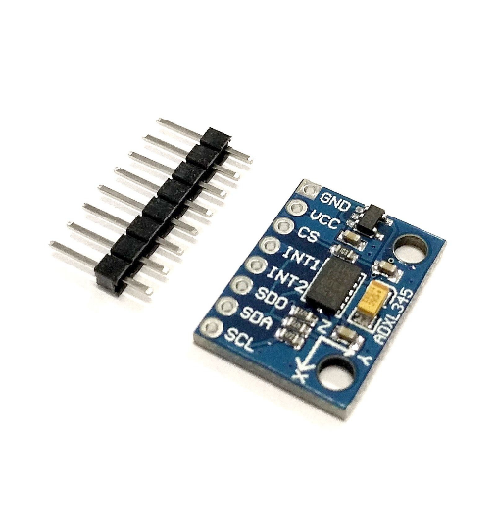
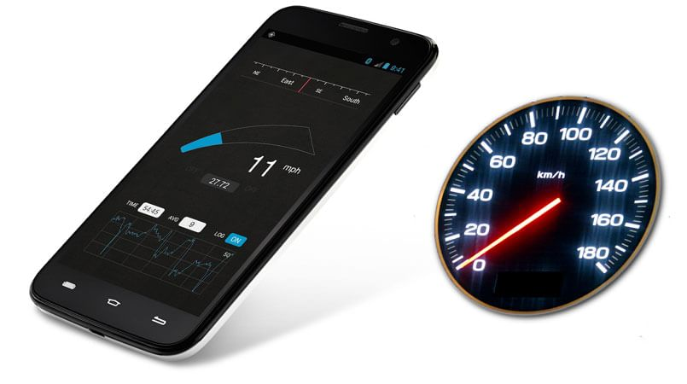
Let’s start with our proposal…
\> From the start, looking at the available sensors, I’ve chosen the ADXL-345 Accelerometer to build onto for the course.
\> The hypothesized thought was to envision a design of a “motion triggered alarm clock”, which saves the use of finding buttons to snooze it and simply uses force to snooze the clock.
\> However in the end, the theorized plan is to build a “Handheld Speedometer,” which would be capable of presenting your speed instantly without any use of radio or GPS waves. Hence the project name… Handheld Speedometer.
\> The final goal was to build the speedometer, display the movement, and if taken further, store into a database the average values of speeds traveled at different times. The end goal of this project was to claim the solution to a problem that the use of radio waves and GPS signals are not necessary to log speed, meaning that it can be used everywhere, such as sitting in an aircraft.
ADXL-345
Dariusz Kulpinski | CENG 317 – 0NA | ADXL-345 3 Axis Accelerometer (0x53)

Slide 3
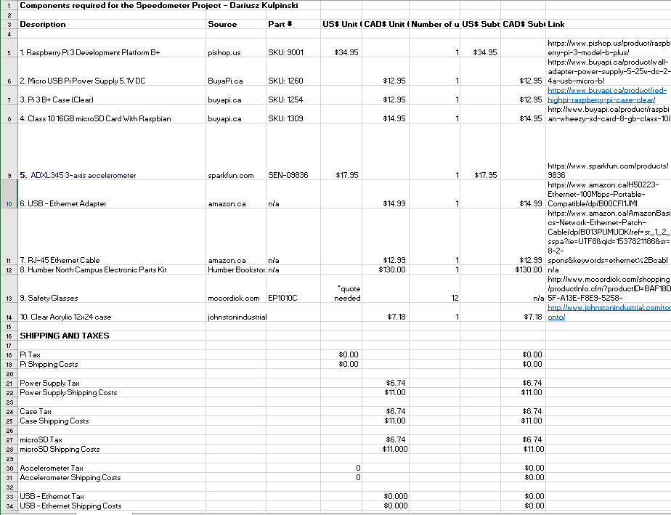

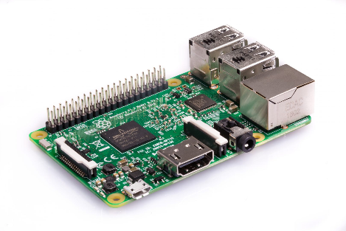
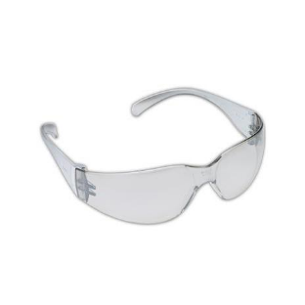
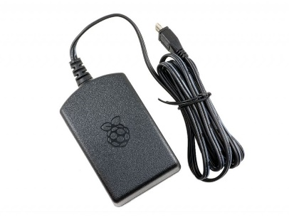
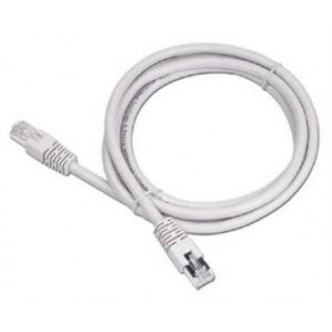

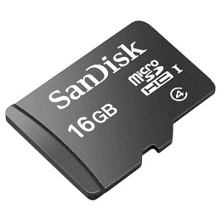
But wait… doesn’t this cost money?
\> Yes it does. That’s why we got the change to establish a budget.
\> A lot of individual parts had to be ordered in order for this project to work. Primarily, what was needed the most was a Raspberry Pi 3 board, and the accelerometer itself. A lot of other components were required such as components to power the pi, connections for testing such as power cables, jumper wires and ethernet cables. Combining all the items together, we got a grand total of around CAD$230 for the parts we needed plus shipping and taxes.
\> There were also components that were already owned, or simply was free to obtain, such as a toolkit, the PCB and casing for the final project assembly itself. Therefore, these didn’t add to the cost.
\> The budget spreadsheet for the project can be accessed here.
Dariusz Kulpinski | CENG 317 – 0NA | ADXL-345 3 Axis Accelerometer (0x53)

Slide 4
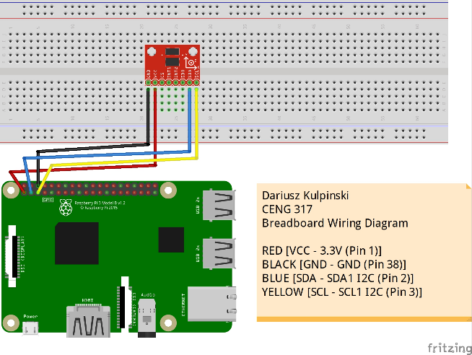
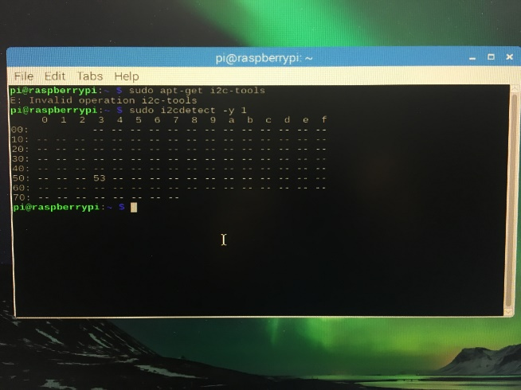
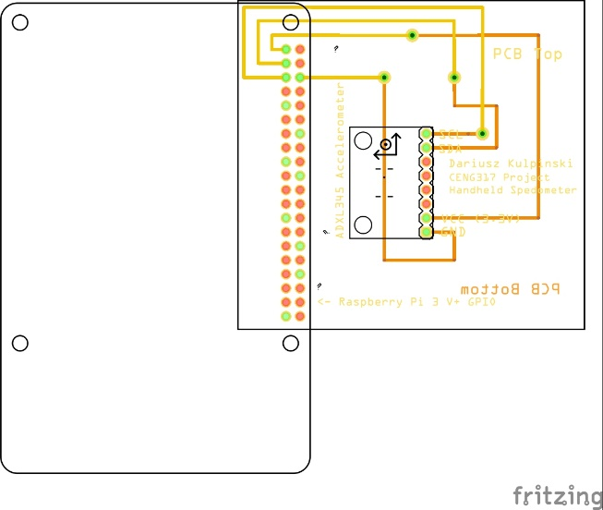
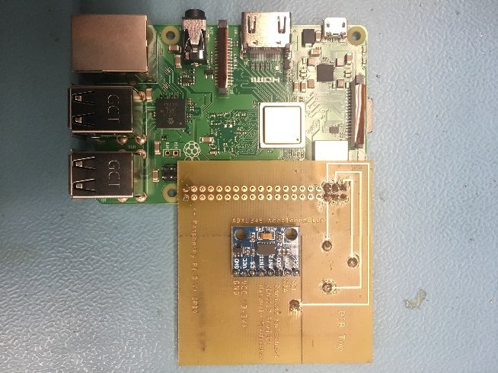
So how is this all going to go down with the time we got?
Week 8a
\> In the beginning, there was a Gantt Chart. This Gantt chart was used to plan out the times and windows that we had in order to implement these procedures to build the device. This started with setting the times for the proposal, followed by the budget, the plan, the design, the soldering, the building, so on so forth.
\> Link to the chart. Although you require Microsoft Project to view this.
\> As time went by, all progress was added to the almighty time log. This time log recorded all the events of the development, the observations, and sample images of everything that should have been completed throughout the project. The time log is summarized as follows: Started with the proposal, made the Gantt chart, created the cost sheet, order the parts, design and build a breadboard, create Gerber files and make a PCB, solder that PCB, test if it works, and make a final enclosure for the whole thing. All these steps were done in a course of 11 weeks, with each milestone in the project completed in one week. Part ordering was completed in 2 weeks.
\> To see the full time log, click here!
Week 8b
Week 9
Week 10
Dariusz Kulpinski | CENG 317 – 0NA | ADXL-345 3 Axis Accelerometer (0x53)

Slide 5
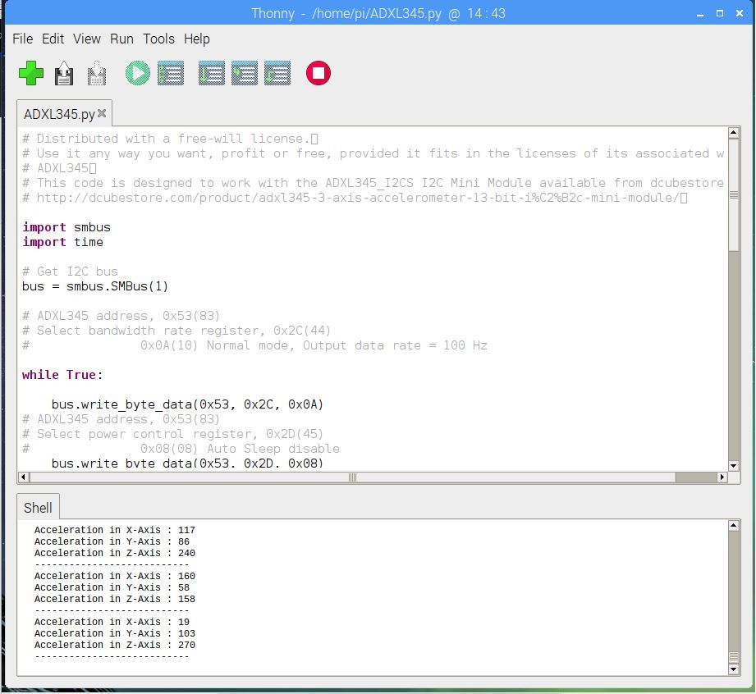
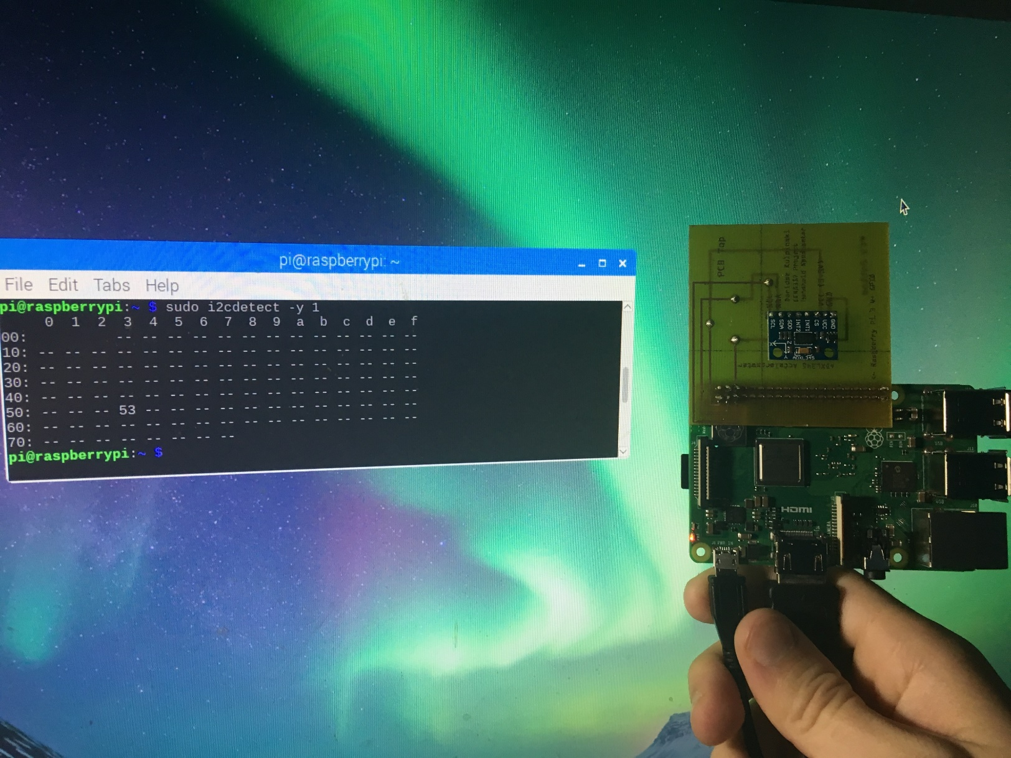
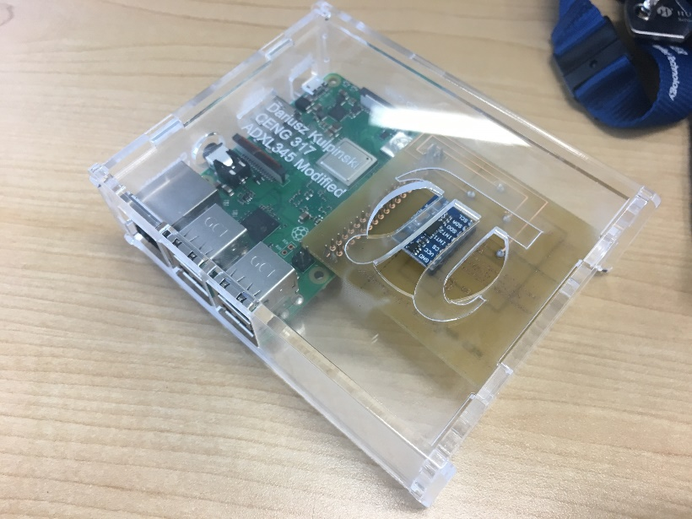
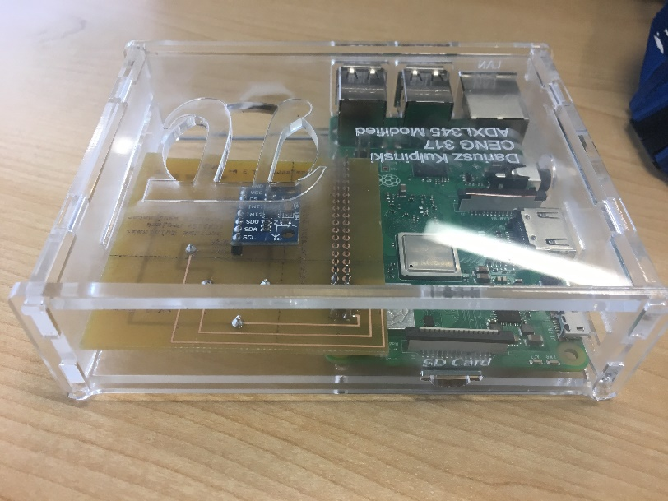
And Voila… The Final Product!
\> After 11 weeks of work and design, the final product is complete. Soldered, assembled, tested and enclosed in a pretty little case, the accelerometer successfully outputs values that can be manipulated for use if this real deal were to be done.
Top: Output result from movement of the sensor
Right: Address Reading of Sensor
Far Right: Images of the Enclosure Final Product
Dariusz Kulpinski | CENG 317 – 0NA | ADXL-345 3 Axis Accelerometer (0x53)

Slide 6
So what courses in the past assisted me here?
\> TECH 103 (Digital Fundamentals) and TECH 101 (Electric Circuits)
This course gave me knowledge on how to build circuits with complicated wiring on a breadboard. Without these course, I wouldn’t have figured out on how to even use a breadboard and how their layouts work.
\> CENG 200 (Unix Scripting) and CENG 252 (Embedded Systems)
These course gave me the knowledge on how to use the UNIX operating system itself and the Raspbian OS. CENG 252 also taught me how to program a Raspberry Pi with its GPIO and other systems. Without these courses, I would not be able to figure out how to use the Raspbian OS and its terminal, and know how to program the pi to actually function.
\> CENG 216 (Software Engineering)
This course gave me the insight of how a project is planned, how it can be carried out, and what to do in order to keep it running smoothly. Without this course, I wouldn’t know what a Gantt chart is and how to generate it. I also wouldn’t know how to even manage the project in its planned steps.
\> WRIT 220 (Tech Workplace Writing Skills)
This course taught me how to generate formal reports and documentation for use in the field. Without this course, I wouldn’t be able to figure out how to apply research and progress reports into documentation.
\> And other stuff in the project not listed above? (Blame CENG 317!)
PCB, Fritzing, Enclosure and GitHub with its perks wouldn’t have been possible without this very course, CENG 317. However, soldering and basic python were self taught, meaning I simply knew how to use and do them.
Dariusz Kulpinski | CENG 317 – 0NA | ADXL-345 3 Axis Accelerometer (0x53)

Slide 7
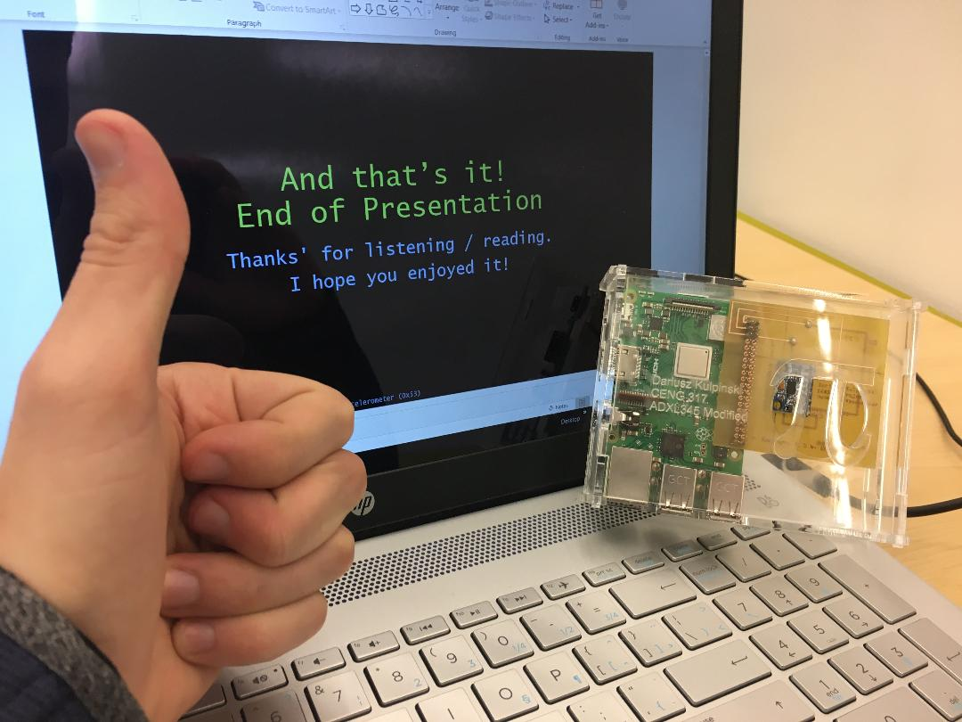
And that’s it! End of Presentation
Thanks' for listening / reading.
I hope you enjoyed it!
Dariusz Kulpinski | CENG 317 – 0NA | ADXL-345 3 Axis Accelerometer (0x53) End of PowerPoint

